Slide 1

Consortium to Assess Prevention Economics (CAPE)
Optimizing Targeted LTBI Testing & Treatment among California’s Foreign Born Population
May 3rd, 2017
Haleh Ashki PhD
This project was funded by the CDC National Center for HIV, Viral Hepatitis,
STD, and TB Prevention Epidemiologic and Economic Modeling Agreement
(NEEMA; #5U38PS004649)
CAPE
Notes:
JGK – provide name that indicates topic of talk. Update date (3 May 2017). Put presenter name too.

Slide 2

Organizations within CAPE
UC Berkeley - UCSF Joint Medical Program
CAPE

Slide 3
Who We Are
Principle Investigators
James G. Kahn, MD, MPH
Paul Volberding, MD
Modelers
Haleh Ashki, PhD
Harinder Chahal, PhD
Jeremy Goldhaber-Fiebert
Eran Ben-David
Alex Goodell, MD^{(i)}
Clinical Experts
Priya Shete, MD
Phillip Coffin, MD
Marion Peters, MD
Senior Program Manager
Devon McCabe
Epidemiologist
Andrea Parriott, PhD
TB Control, CADPH
Jennifer Flood, MD, MS
Pennan Berry, MD, MPH
Peter Oh, DrPH
CAPE
Notes:
JGK – put Modelers first for this presentation

Slide 4
Research Questions
What is the epidemiologic and economic impact of expanded testing and treatment to classes of immigrants not currently screened?
What is the best test and treatment scenario to reach pre-elimination?
What is the impact of a combination of these strategies?
CAPE
Notes:
TB elimination of strategies to expand upon current screening of refugees and documented immigrants for active TB. Specifically, we will explore two expansion strategies: a) Expand TB testing and treatment of refugees and documented immigrants to include LTBI, not just active TB; b) Expand active TB testing and treatment to classes of migrants not currently screened (e.g., students, asylum seekers, seasonal undocumented workers); and c) Both strategies in combination.

Slide 5
Background
CA has largest burden of TB in the US with 2,137 Cases in 2015
Incidence rate of 5.5/100 000
Estimated 7% imported cases, 13% recent transmission and 80% reactivation (2015)
CAPE
Notes:
Background slide, key stats to frame discussion, for example for TB in CA you may put the following:
Highest TB burden in US states
~25% of TB in the U.S.
One active case every four hours
Large foreign-born population:
> 10 million immigrants (27% of CA pop.)
~25% of foreign-born in U.S.
World Health Organization calls for TB elimination in low-incidence settings

Slide 6
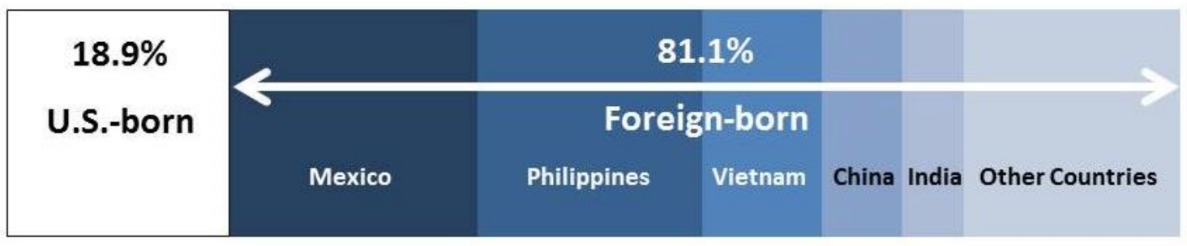
Background
27% of CA population is FB
TB in CA disproportionately affects FB (incidence 16.5/100 000)
81% of all TB cases are in FB
from CDPH TB Fact Sheet 2016
CAPE
Notes:
CA has significant foreign born population representing about 27% of the total population of california and if undocumented included is approximately 10.4 million people of a population of about 30 million.
Because of this the FB population has the potential to be a significant in terms of CA TB Control

Slide 7
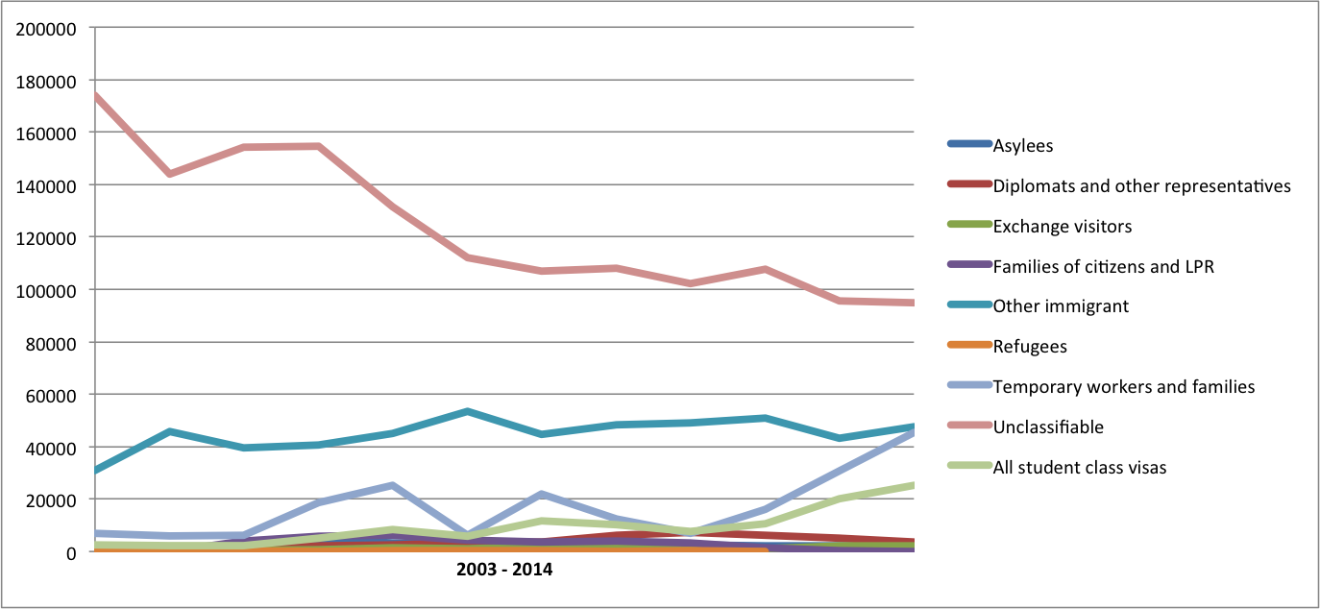
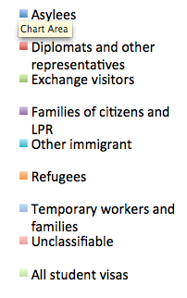
New immigrants by visa classes in California
CAPE

Slide 8
Main topics for this talk
Model aspects and design
Initial validation: Population diversity and Risk factors
Parameter Estimation:
Risk of progression
Risk ratios
Targeted test and treatment design
Results and analysis
CAPE
Notes:
JGK – put Modelers first for this presentation

Slide 9
Transition by using community based formula
Uninfected
LTBI
Age, Sex Race Birthplace Visa status
HIV
ESRD
Smoking
Diabetes
TNF-alpha
Decrease as world LTBI decreasing factor
Risk of progression based on months since infection
Uninitialized
Test
Positive
Active TB
Treatment
CAPE
Notes:
JGK – Pretty! How well this works depends on how it’s explained. I think you need an arrow from treatment to “Cured” or “Uninfected”
HA: There is no such a transition in the model. People in treatment, after finishing treatment, by efficacy value get less likely to get TB.
HA:I will spend some time in this slide to explain the transitions, parameters, formulas we are using as well implementation structure.
The simplest way to show the overall view of our model. Since its an individual based model, each combination of attributes generate new transition probability, in other words new arrow in the model.
Test and treatment have different sensitivity, specificity values, and have cycle of treatments.
Testing by itself is combination of different scenarios, targeting different people with combination of attributes.
Some attributes are been updated in the simulation at each cycle as, months being in US, changing between visa status, month of test, monthly rate of getting of each of the risk factors, monthly leaving (both out-immigrants and death rate), etc.

Slide 10
Validation of model for risk factors
CAPE
Notes:
JGK I like these images, important stuff. However, completely unreadable. You might be able to fix with larger font for all writing, or you can do multiple slides, one graph per slide.
JGK might want to put calibration methods before these results (they are results, right?)
HA: The calibration formulas are simple, I didn’t use the MCMC for those, very similar to what Alex has used for calibration too. I have used the MCMC for RR and RP, that’s why I didn’t put it here.
HA: I changed the font size and the line width, if still is unreadable, then would be better to put them in separate slides.

Slide 11
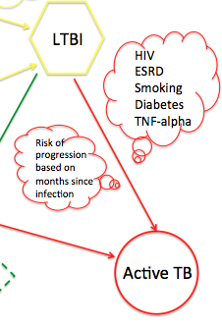
Parameter estimation using Markov Chain Monte Carlo (MCMC)
Risk Ratios
Risk of progression
MCMC methods are a class of algorithms for sampling from a probability distribution based on constructing a Markov chain that has the desired distribution of its equilibrium distribution
CAPE
Notes:
Let’s take an snapshot of where in the model we are talking about?
In simple words, we get input, run the model and get the output, and then we compare the out output with historical data. Since we assume our model structure is as close enough to reality, we are not changing the model structure, therefore to have better outputs (match with historical data) we have to improve our input data to be more accurate.
MCMC [JGK – spell out the acronym once!] is n statistical method to estimate the range of input data that produce better output. Then we can use that to improve our input data.
JGK – At the TB meeting on Wednesday, the audience will include very technical folks – modelers and statisticians. So please get into more technical detail. I.e., state at the higher non-technical level, as you have, and then spend 2 minutes on more technical explanation. Eg how fit is defined, how new values are chosen, when the MCMC is deemed satisfactory / done.
HA: sure, I will explain MCMC in detail.

Slide 12
Risk of progression estimation
Risk of progression where the risk of progression in month t after infection (P_{t}) is determined by the following equation:
P_{t}= P₀e^{-λt}
CAPE
Notes:
JGK – good this is more of the technical detail. However, completely unclear what the graphs show. You need readable axis labels (the numbers) and you need to add axis titles (which is shown on each axis).

Slide 13
Challenges
MCMC estimates P₀ and λ for each year but we need a one value for each. To find the best P₀ and λ we tried three different approaches:
Using only two different P₀ and λ for before and after 2009 where we have jump in MCMC estimation.
Using one value as an average of all P₀ and λ
Using P₀ and λ as normal distribution with mean and sigma as average of all P₀ and λ estimated by MCMC.
 | Mean | Standard deviation
P₀ | 0.00378 | 0.00025
λ | 0.0377 | 0.00112
CAPE
Notes:
JGK – good this is more of the technical detail. However, completely unclear what the graphs show. You need readable axis labels (the numbers) and you need to add axis titles (which is shown on each axis).
HA: the best approach is number 3. Since its stochastic and we run it for many times and get the average of all results, the distribution solution guves the best results.

Slide 14
Risk of progression estimated by month since infection
CAPE
Notes:
JGK – better labelling, but font still too small. Also is this the risk of progression from your formula? Is it calibrated?
HA: yes, its P(t) formula result by using P0 and lambda estimated by MCMC. Meaning the RR for each individual in the model is calculated by this formula based on his month since infection.
I didn’t get what do you mean by is it calibrated? Calibrated to what?

Slide 15
RP error range
CAPE
Notes:
Do you think this slide is needed?

Slide 16
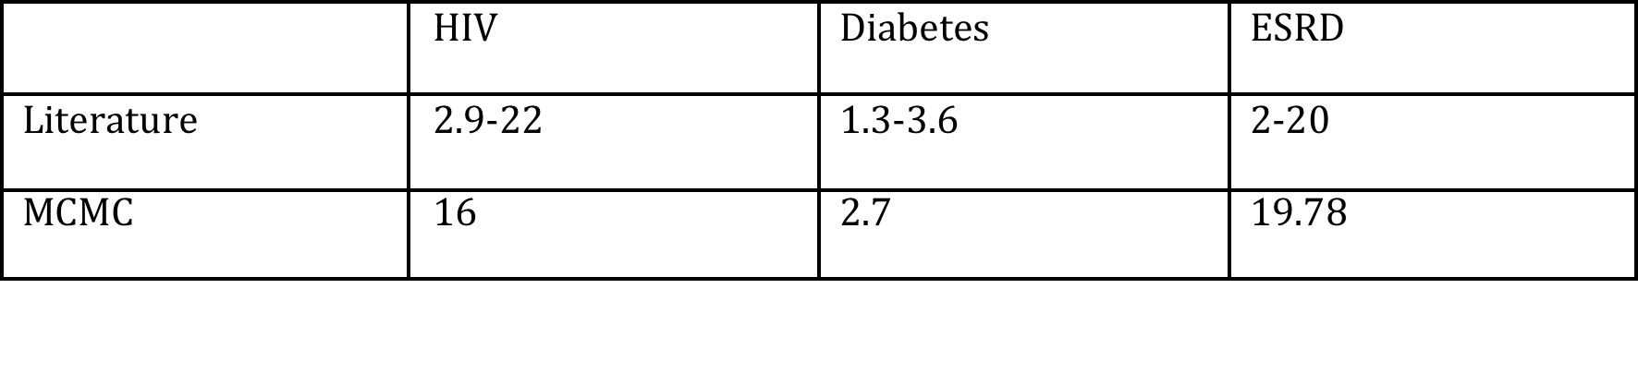
Estimated Risk ratios
Limitation: Control data is available for only few years
CAPE
Notes:
JGK – Need to be able to read the axis labels, MUCH bigger font. How did you estimate the risk ratios? From calibration?
HA: From MCMC

Slide 17
TB trend by estimated parameters
CAPE
Notes:
HA: the two point of bump are because: the P0 estimated for first two years are less than the other P0s, so instead of having 2 values for P0 we decided to have one.
At 2009, we have jump on new immigrants that tend to have a little mismatch

Slide 18
TB trend estimation till 2040
CAPE
Notes:
We are not even close to TB elimination. Lets look at TTT results.

Slide 19
Base-case scenario
Testing 4.5% of population annually.
Subtracting the number of people get green cart, because they have been tested for the process.
CAPE
TB trend till 2040 only applying base-case TTT
Notes:
JGK – spelling “card” not “cart”. Nice graph! (but larger font pls)

Slide 20
TTT scenarios
Previously tested scenarios:
Base_case: Current LTBI screening (random, .004 uptake)
Foreign born testing: (2x(.004), 4x, 10x uptake)
Risk factor testing: (2x(.004), 4x, 10x uptake)
New tested scenarios:
Visa-class: Screening new immigrants based on their visa classes
Universal on Arrival: Screening all new immigrants that have classifiable visas
High prevalence: Screening people in higher prevalence targeted population using combination information of visa classes and risk factors
CAPE
Notes:
Old and new ones
HA: question? Is “High prevalence testing” a good name for this scenario?

Slide 21
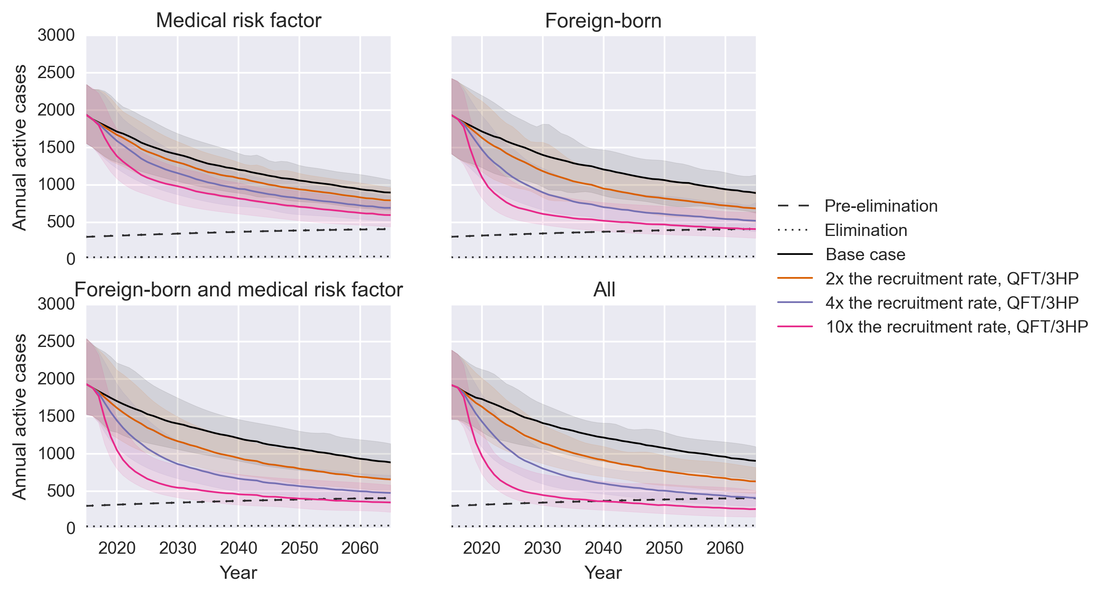
Previously TTT results
CAPE
Notes:
I borrow this plot from Alex paper to have a review of what we got from Y1.
I asked him for his permission but have not heard back. If you think its not needed, delete it.
With 10x FB testing we reach pre-elimination at 2070 if we start TTT at 2016

Slide 22
Visa-class testing scenario
Testing new immigrants with three largest visa class population : Student, Temporary workers and Immigrant visa classes.
The population target sizes are small (limited number of new immigrants in classifiable visa status), and their LTBI prevalence rate is almost the same. Therefore the tastings have almost the same effect on reducing TB active cases.
CAPE

Slide 23
Universal on Arrival testing scenario
Testing people from top 5 countries at their arrival in classifiable visa status.
CAPE
Notes:
I keep the universal on arrival testing and base-case for all other TTT as default.

Slide 24
Comparing Universal at arrival and Fb2x
Cumulated testing on Universal on Arrival is less than FB2x testing
FB2x :625835 Universal on Arrival: 575400
CAPE
Notes:
From now on, for all tests I have base-case and Universal as default testing

Slide 25
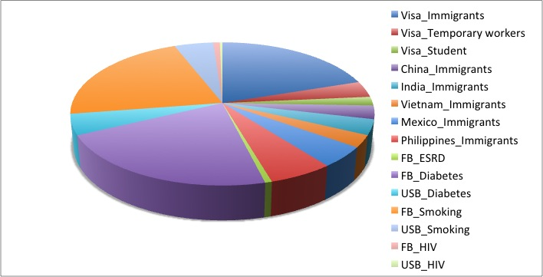
LTBI diversity at 2014
Largest population
People with immigrant visa and not tested in previous year.
Foreign born population with diabetes and smoking
All HIV infected people
CAPE
Notes:
JGK – legend font size! Might want separate slide on Target population bullet list – this is important! And show #s vs. your prior slide on arrivals

Slide 26
High prevalence targeted population testing result
CAPE
Notes:
It gets smooth around 2030, let’ compare the targeted population size in LTBI states at 2020(before TTT) and 2030.

Slide 27
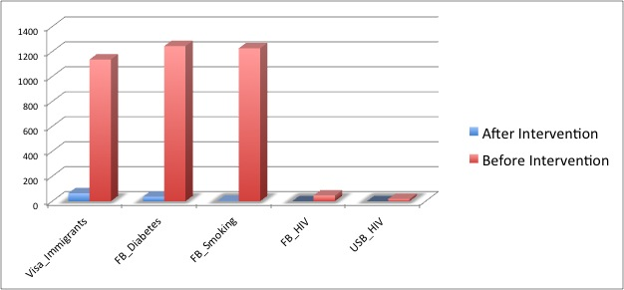
LTBI diversity before and after TTT at 2014 and 2030
CAPE
Notes:
Shows the intervention has worked.
Lets see what are the largest group at LTBI population at 2030

Slide 28
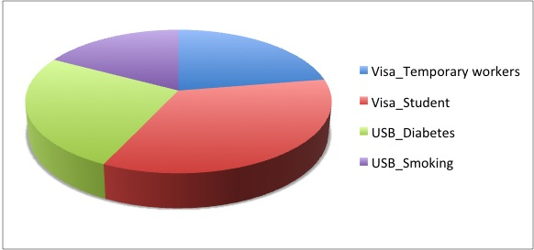
Largest population in LTBI state at 2030
CAPE
Notes:
So its good to included them to high prevalence testing to see what we get

Slide 29
Comparing 3 and 7 targeted LTBI population results
CAPE
Notes:
So its good to included them to high prevalence testing to see what we get

Slide 30
Comparing 3 and 7 targeted LTBI population with Fb4x and FB 10x and the number of test
CAPE
Notes:
I would like to compare the cumulative number of tests and results, The jobs are still running, so will add them when its ready.

Slide 31
Limitations
Lack of control data tend to uncertainty in parameter estimation.
Small sample sizes make projections challenging in an Individual based stochastic model
Population projections past 2014 carry significant uncertainty
Base case testing uptake may be an overestimate
Modeled only >= 15 years old
Did not model undocumented
Inter-person transmission does not account for geography or households
CAPE

Slide 32
Overview and Conclusion
Individual model based on Markov chain process
.Pros: Having so many parameter for better modeling
.Cons: Increasing uncertainty
Using numerical algorithm for calibration (MCMC)
Capable for having as many as demographic and biomedical attributes:
.Better and more accurate modeling
.Better TTT design
Capable of extension for more than one state/region, by having initial information of new regions.
CAPE

Slide 33
Future work
More TTT designs:
With high prevalence testing, most of the pre-infected people are tested.
With Universal on arrival, new immigrants are tested, so the initializing to LTBI is been covered.
The transition to LTBI happen based on new active cases, with more weight on being in same community (in our model, its based on race and being foreign or US born), so maybe having only Universal on Arrival testing and community based testing can have better effect.
CAPE
Notes:
This slide need more discussion with team .

